Slide 1

COMSATS UNIVERSITY ISLAMABAD, LAHORE CAMPUS
Recommendation System

Slide 2
CS-28
--
Final Year Project -1
Supervisor:
Ma’am Kanza Hamid
Recommendation System
Team Members:
Ibad Ahmad – SP18-BCS-159 (Group Leader)
Haseeb Yaseen – SP18-BCS-047
Wahaj Hafeez - SP18-BCS-007

Slide 3

--
Introduction
RS background and their types
Content Based, Collaborative, Hybrid techniques
Uses in Different Domains
E-Commerce, Streaming etc.
Why Recommendation System?

Slide 4

Problem Statements
Multiple Platforms for Multiple Businesses
Balance between reviews and ratings
Not considering contents of the reviews
Google Recommendations, Food Panda, Play Store etc.

Slide 5
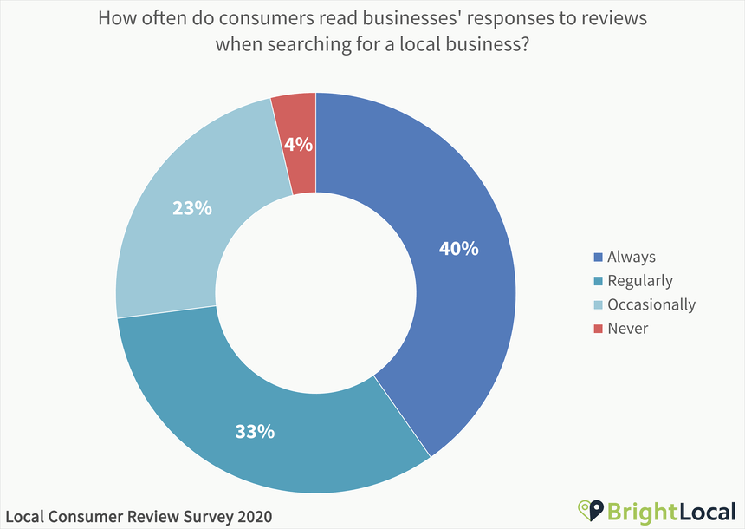
Importance of Online Reviews in Digital World
As of January 2020
Online Reviews Based Trust Ratio continues to rise day by day in more countries and cities.

Slide 6
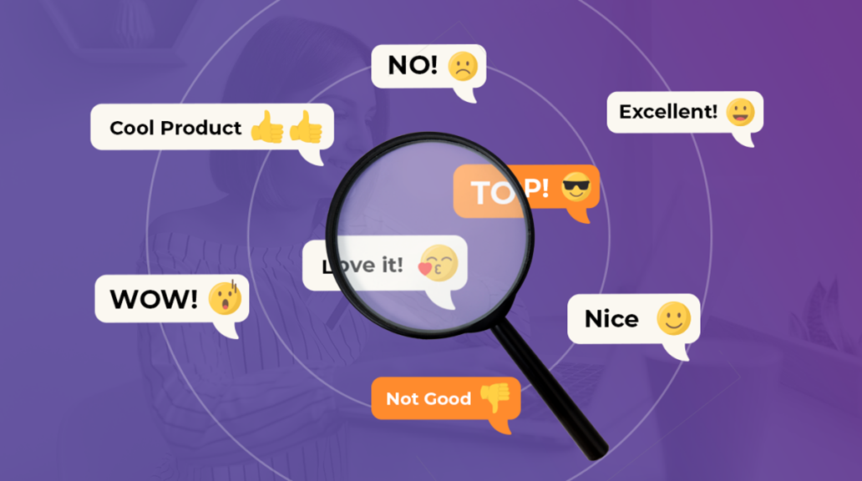
System Objectives
Goal to achieve
Our idea is to come up with a generic recommendation system that would be able to recommend different businesses on the basis of reviews. Moreover, we will add Reinforcement Learning so that this process becomes dynamic

Slide 7
1
Recommend on the basis of feedback from group of people
2
Content of Review i.e. emoticons and emoji's
System Objectives
3
System’s intelligent ratings
4
Take updated user feedback into account
5
Incorporate Multiple Businesses in single platform

Slide 8
Pre-Decided Locations
Projects Scope
Initial Review
Language Barrier
Appointment and Bookings

Slide 9
Yelp
Yelp is a social networking site that lets users post reviews and rate businesses. When you go to a new restaurant and have a good experience, it's likely that you won't keep the place a secret.
Existing Systems Study
Similar Online RS based services
TripAdvisor
TripAdvisor, Inc. is an American online travel company that offers online hotel reservations and bookings for transportation, lodging, travel experiences, and restaurants.
Urban Spoon
Urban spoon was a restaurant information and recommendation service founded in 2006 by former Mobster employees that offered its services in North America and parts of English-speaking Australasia and Europe.

Slide 10
Our System
Food Panda
Cheetay
Multiple businesses incorporated.
Cover specific range
Intelligent System ratings
Dynamic Workflow using Reinforcement Learning
Grocery and Restaurants
Works in Pakistan
User averaged ratings
Not considering reviews
Grocery and Restaurants
Operates in specific cities
User averaged ratings
Not considering reviews

Slide 11

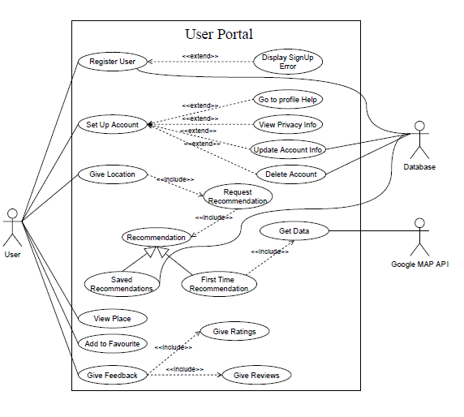
Use Cases

Slide 12
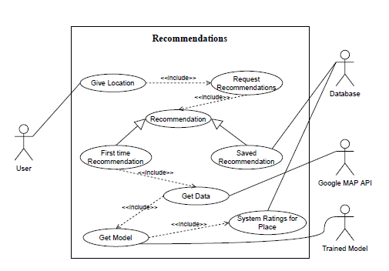
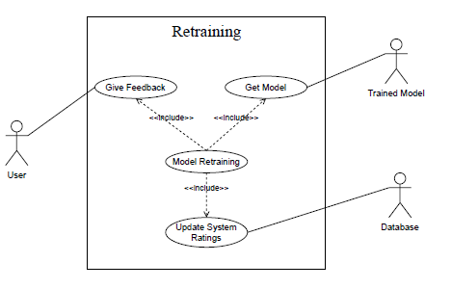
Use Cases

Slide 13
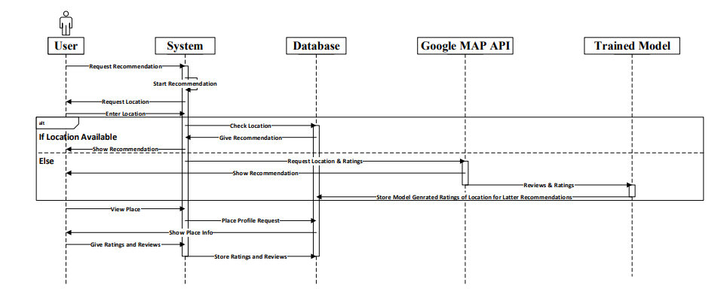
Sequence Diagram

Slide 14
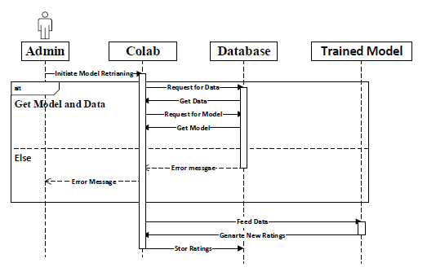
Sequence Diagram

Slide 15
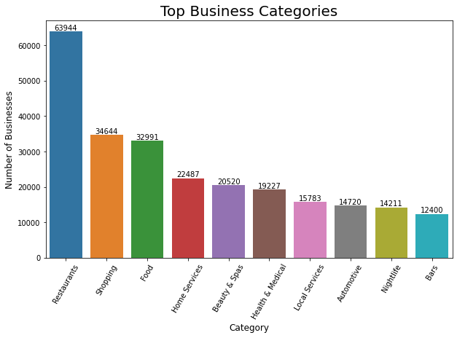
Total Businesses

Slide 16
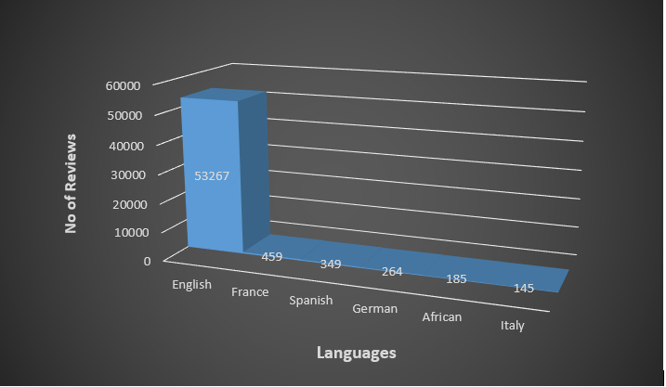
Languages in Reviews

Slide 17
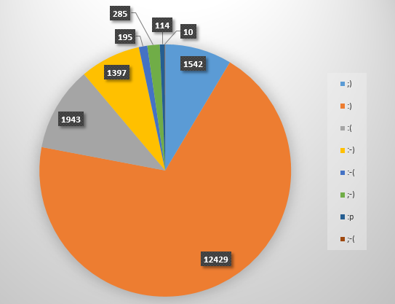
Emoticons in Dataset

Slide 18
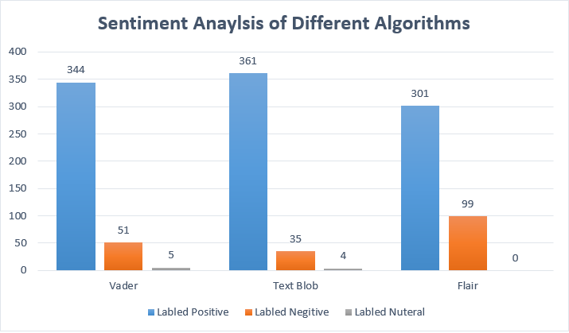
State of the Art Models

Slide 19
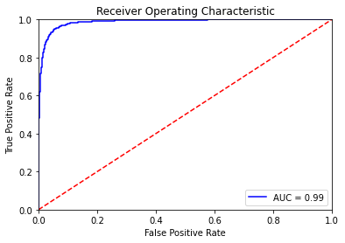
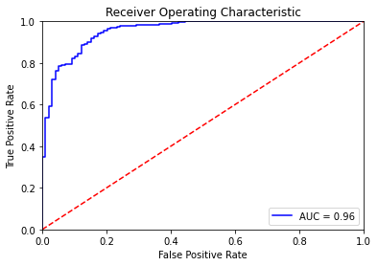
BERT Model Evaluation
IMDB Dataset
Testing

Slide 20

Do you have
any questions?
Ask to us! We hope you learned something new.

